Slide 1




FINAL
REPORT
PRESENTATION

Slide 2

Gaurav Sharma
I am Gaurav Sharma, a passionate Computer Science Engineering graduate from Chandigarh University with experience in full-stack web development, particularly in technologies like ReactJS, NodeJS, ExpreeJS, ThreeJS, SQL and MongoDB. During my internship at Meander Software Development and job at Fortec Web Solutions, I honed my skills in crafting dynamic websites and applications. Additionally, I've engaged in freelancing projects and also some projects under PMKVY 4.0 Future Skills program in partnership with IBM, enhancing my expertise in both web and mobile development. With a keen interest in problem-solving and a diverse skill set ranging from digital marketing to various technical domains, I am committed to leveraging technology to drive innovation and create impactful solutions.

Slide 3






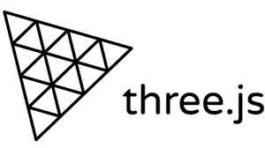










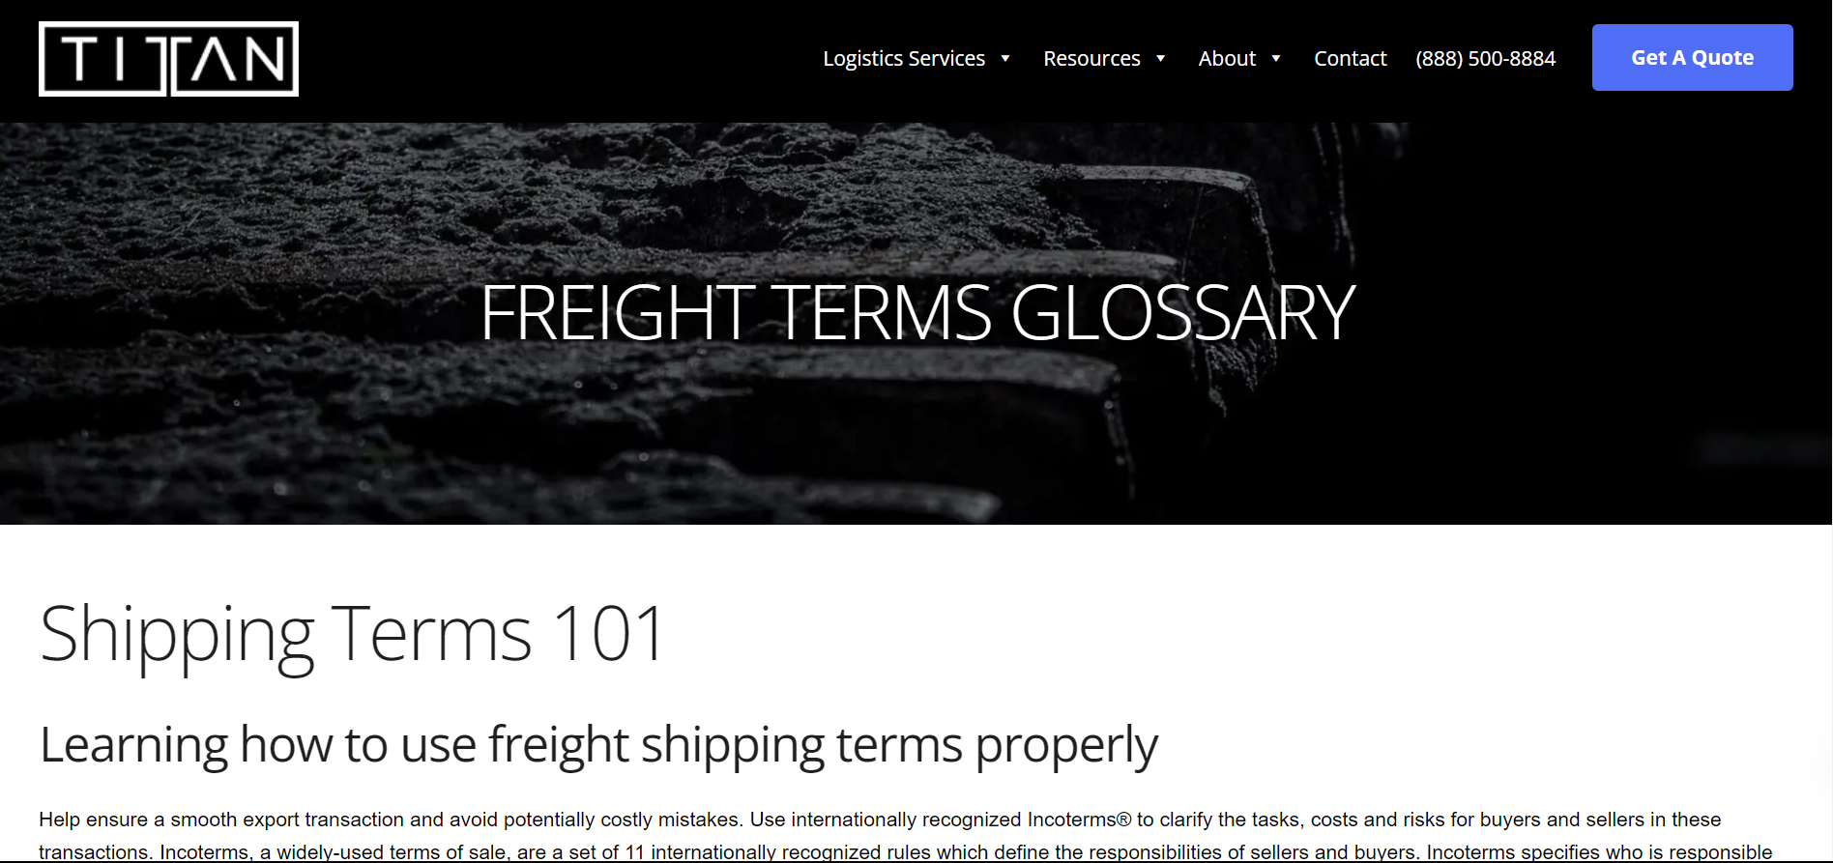
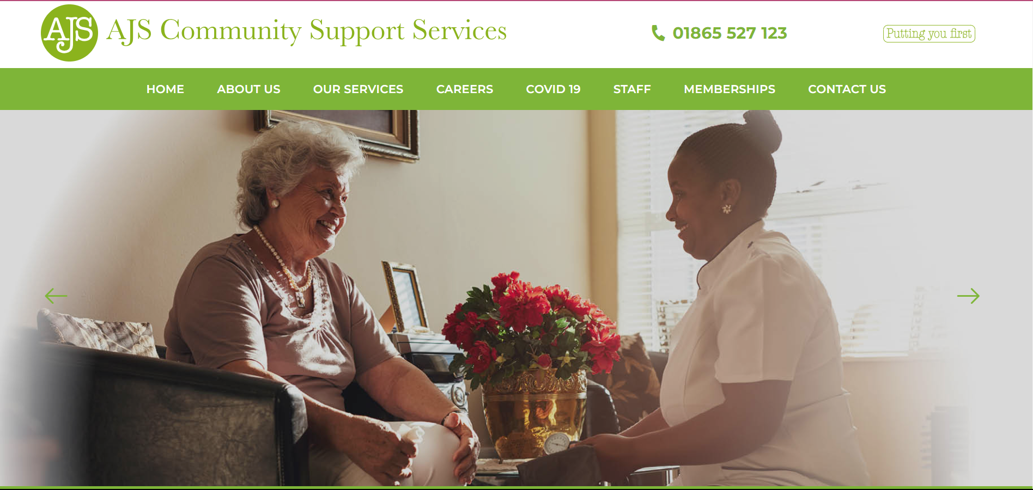
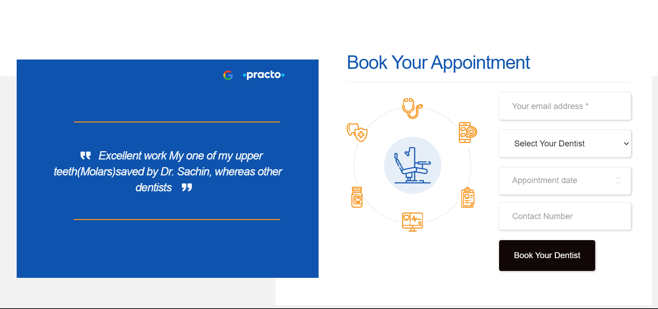
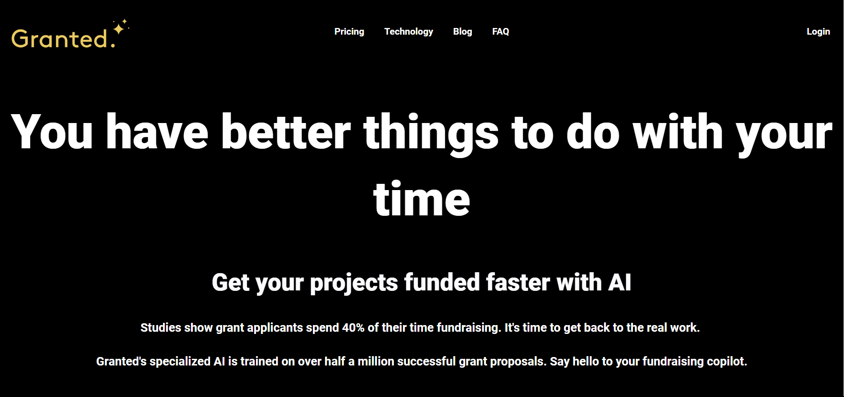
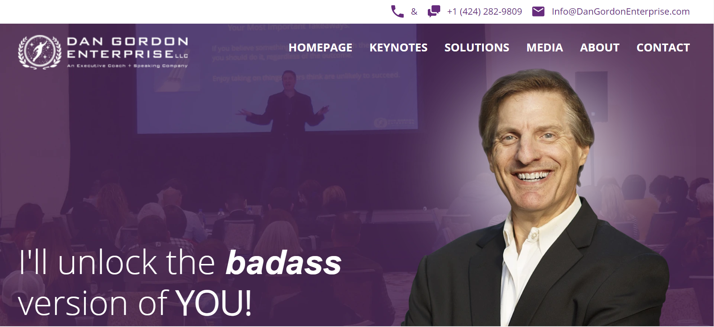
PLATFORMS
EXPLORED
&
WORK
DONE

Slide 4

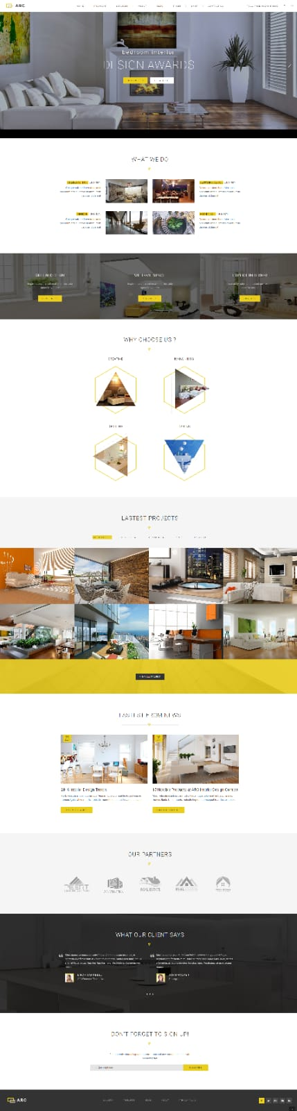
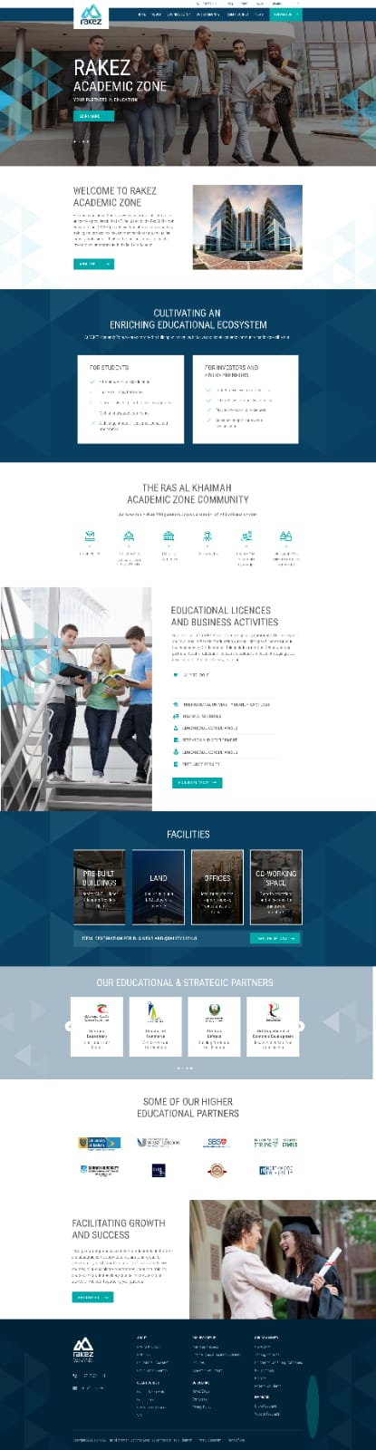
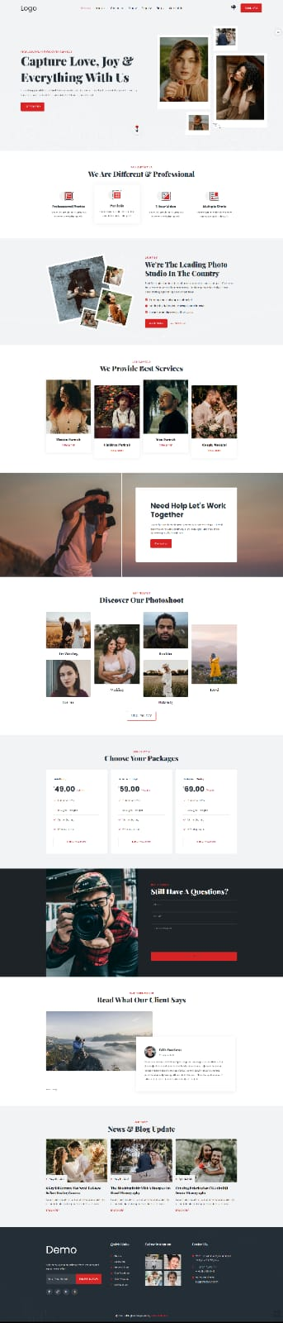
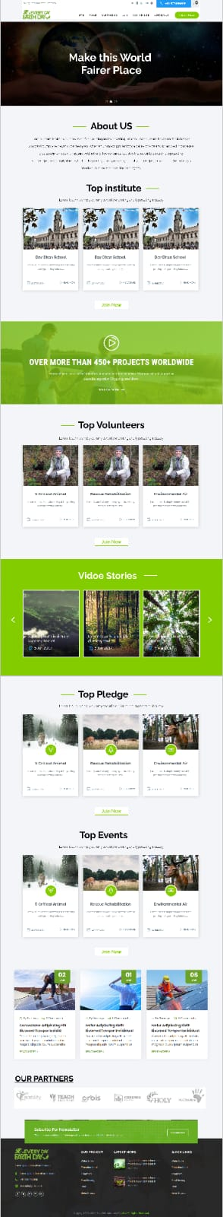

FIGMA
DESIGNS

Slide 5
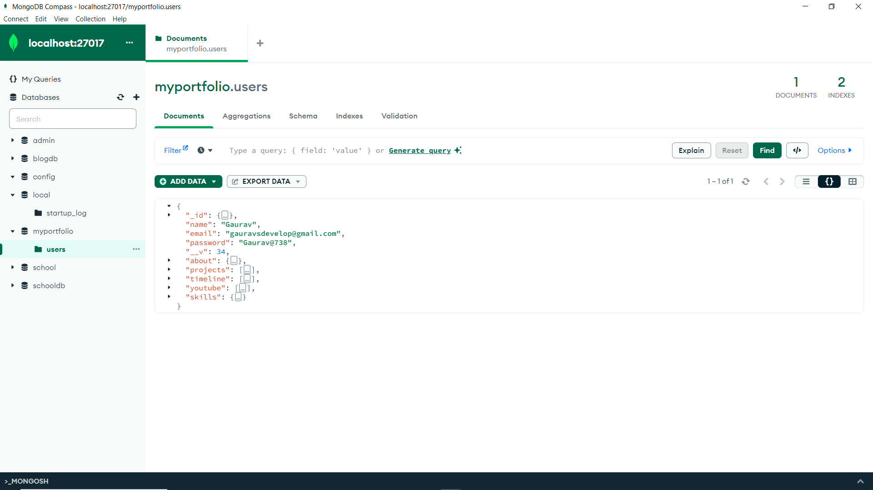
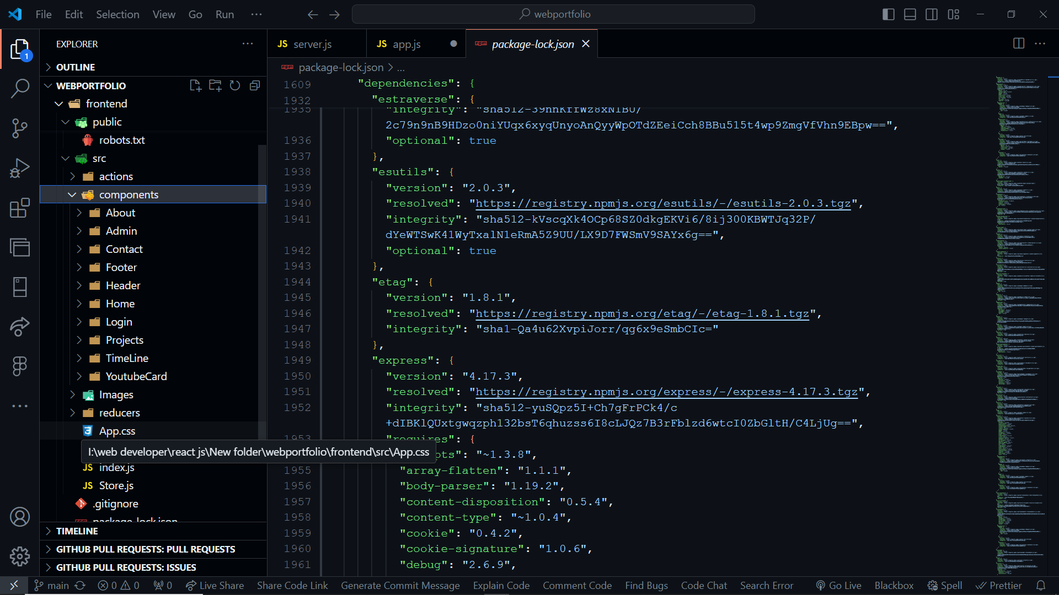
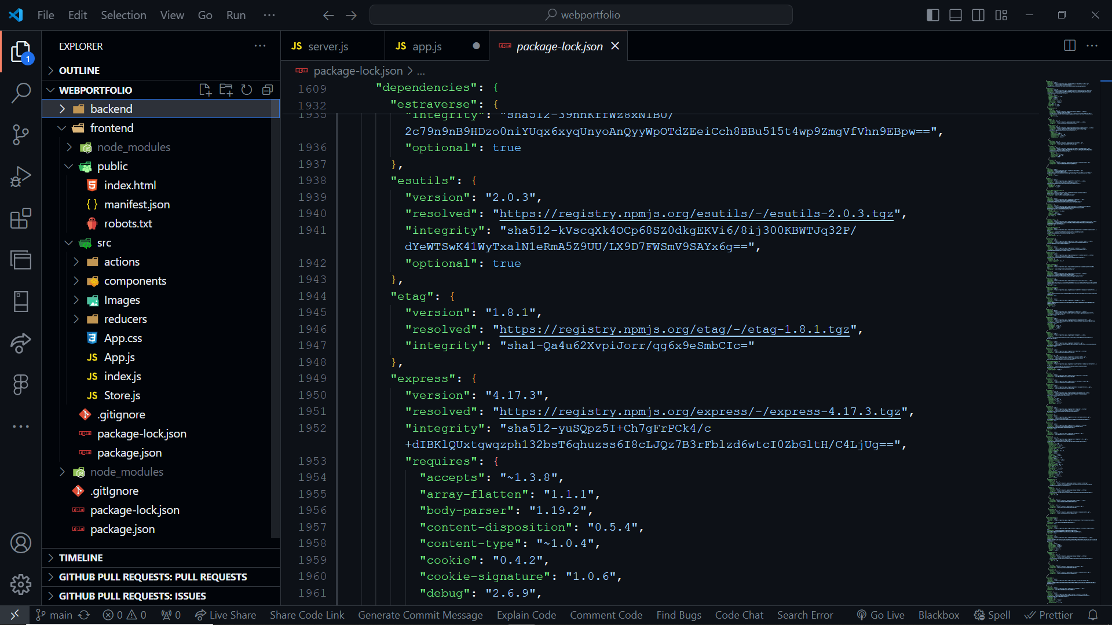
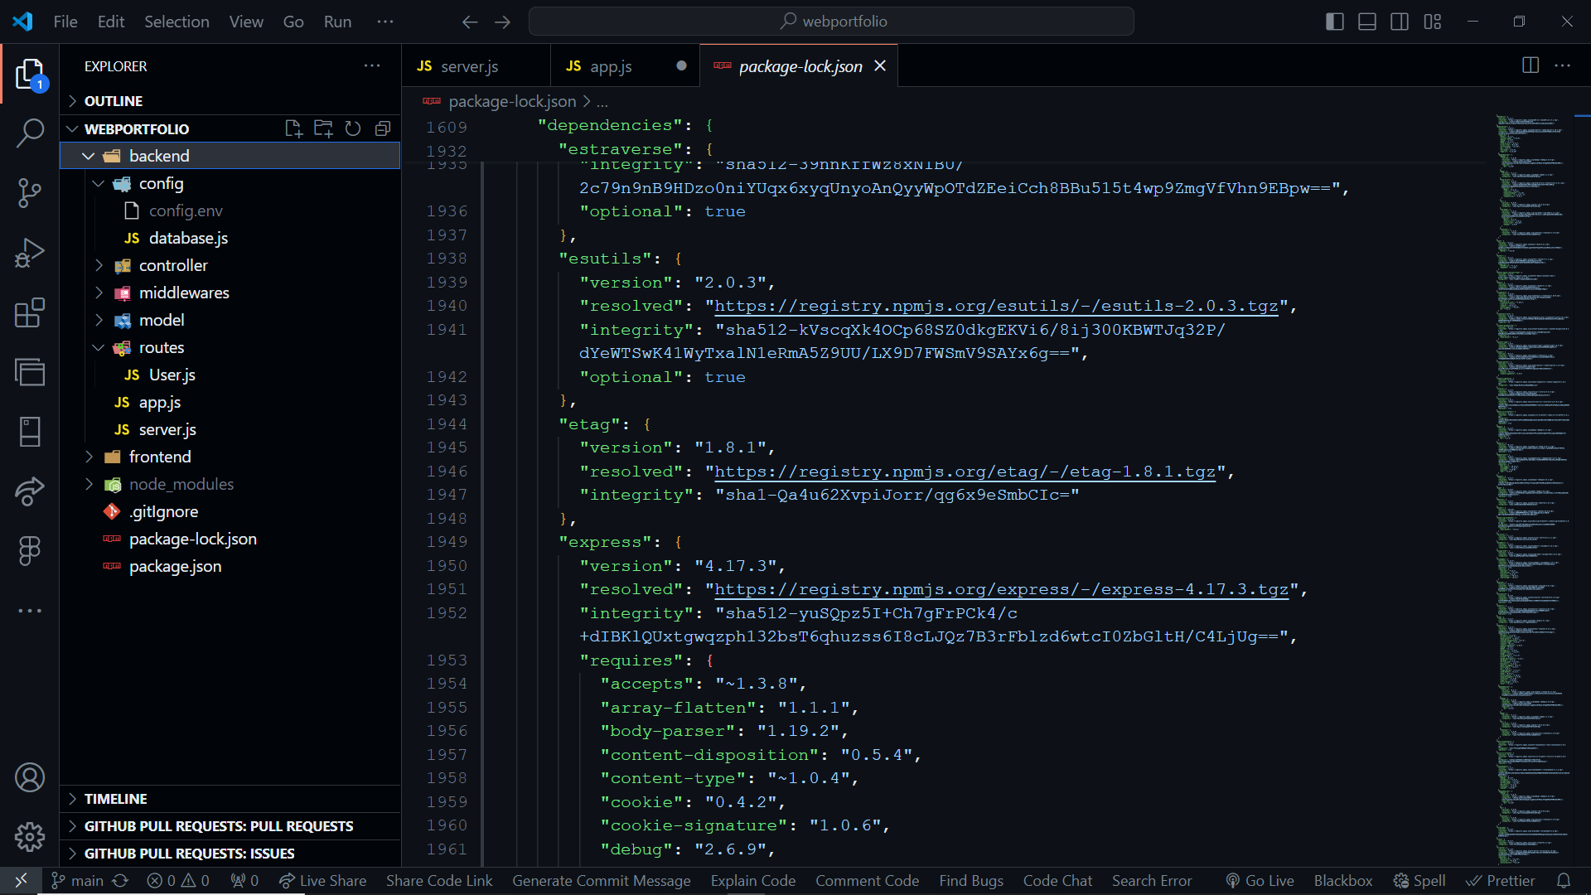
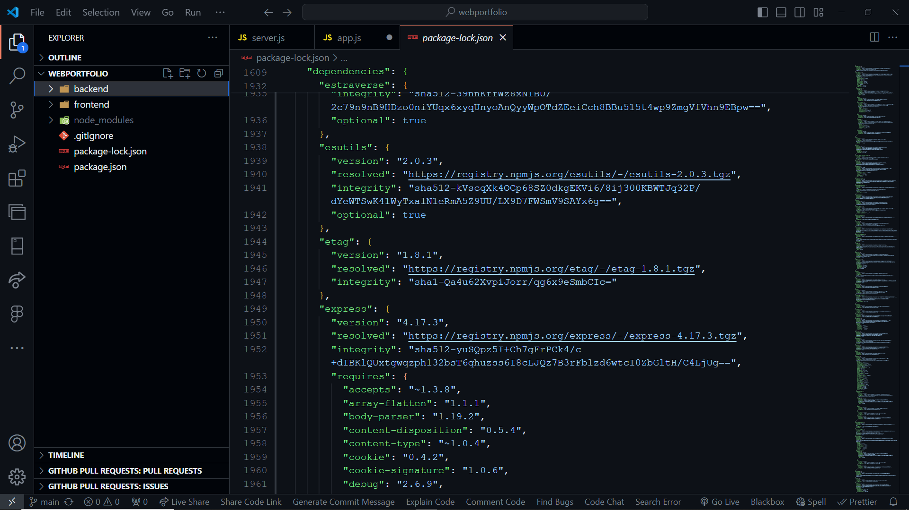
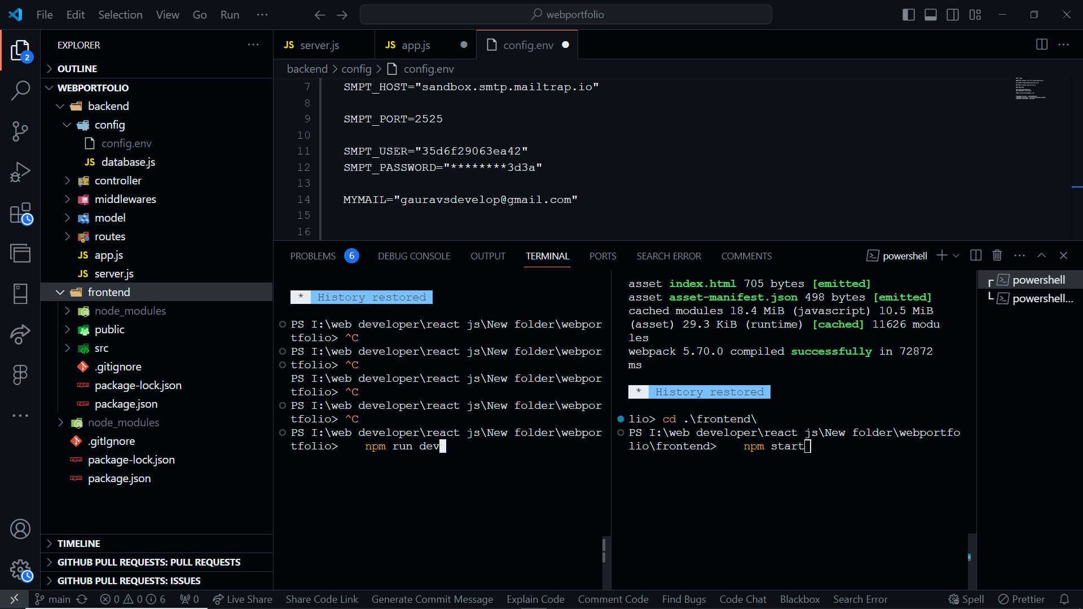
MERN BASED TRAINING PROJECT
(FILE STRUCTURE)

Slide 6

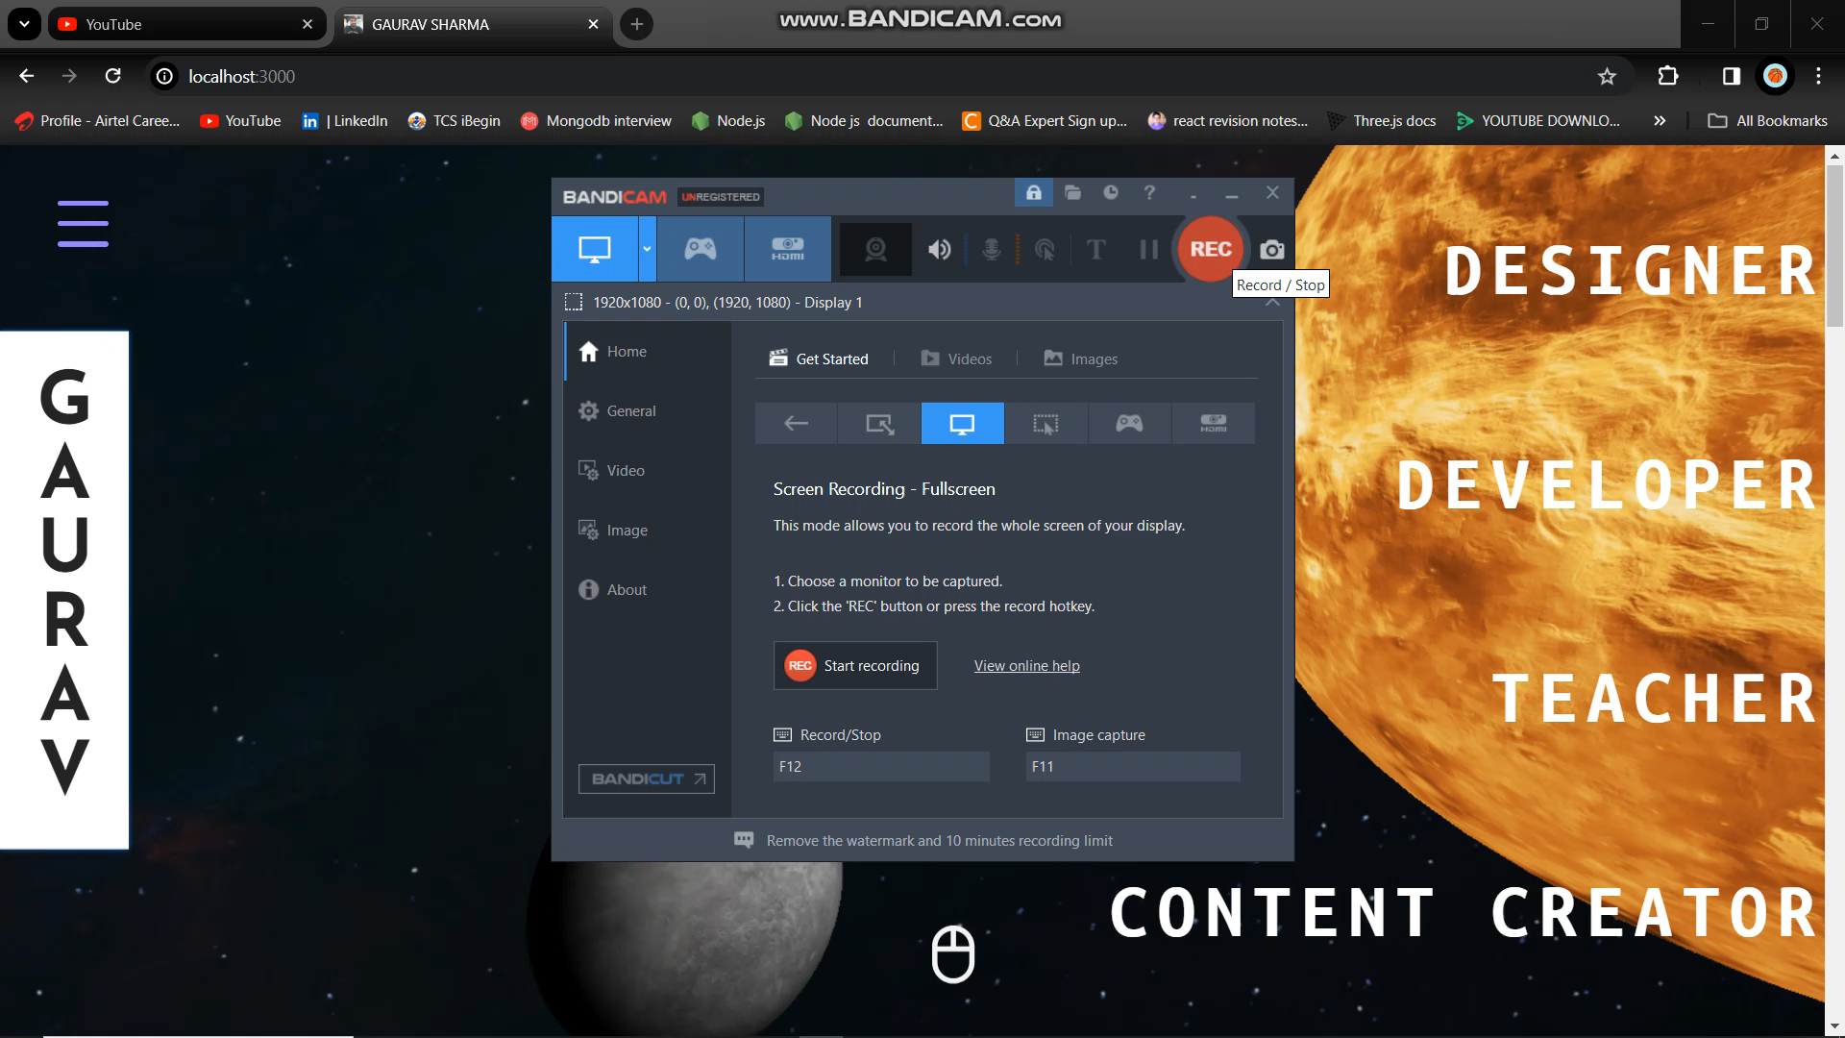
PROJECT
LINK
3D PORTFOLIO

Slide 7

Thank
You

